Slide 1
Cyber Crime Investigations
Investigation process
Prof. Shumba
January 16,2019
© Copyright 2014: Jenny A. Applequist. All Rights Reserved.

Slide 2
This week’s goal
What is involved with a forensics investigation from the beginning to when you hand off your results in the form of a forensic report to the party requesting your services?

Slide 3
Coverage
Investigation steps (using Casey(2002) model):
Assess:
Pre-investigation checklist
Opening a forensic case and logging work.
Search and seizure
Role of the chain of custody
Acquire:
Analyze:
Report writing and reconstruction
Critiquing the case

Slide 4
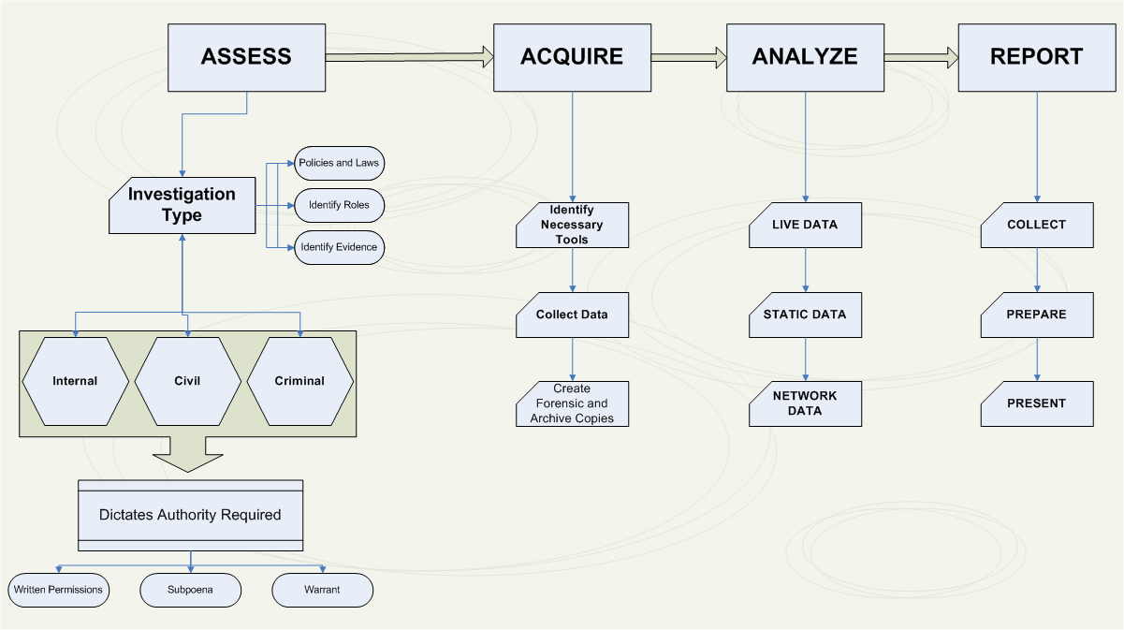

Slide 5
Pre-investigation checklist
Know the goal of the investigation
Know who the first responder was
Have a solid documentation of the environment to be investigated.
Validate that you can access all systems on the asset list (US laws, search warrants)

Slide 6
Pre investigation checklist
Assumption: Some event has occurred, and you or your team are brought in to understand what exactly happened.
Have to understand the goal of the investigation.
What example questions can you ask to understand the goal of the investigation?

Slide 7
Goal of the investigation
What incident is being investigated?
Who is involved?
How does it impact the organization?
What devices are involved?
Are there any politics to be aware of?
Are there any clearance requirements?
Do we need a search warrant?

Slide 8
Who was the first responder?
Not always the first person on the scene.
Usually the first person who realized an investigation needs to occur.
How does the responder affect the rest of the investigation process?

Slide 9
First responder and the process
If the first responder does not follow an acceptable procedure -> failure in evidence collection.
First responder has to be trained.
Should list all devices involved and ensure a process to add or remove devices.

Slide 10
Documenting the environment
What are the things that you would need to capture to document the environment being investigated?

Slide 11
Documentation of the environment
List of first responders with contact information
Asset list for devices of interest
An order of volatility for artifacts of interest
The electronic serial number of the drive and other artifact-specific data
A record of any system clock drift
Video, photograph, or sketch of the scene of the incident if no other methods are available
Contact information for any witnesses

Slide 12
Authority to access the systems
Validate that you are authorized to access every system on the asset list
US laws that protect device privacy.
May need to obtain necessary warrants for search and seizure.
To access systems on a live network, such as a firewall or router- obtain a network diagram
Maybe told to request data, and another authorized person is used to obtain the data. What problems do you see with this?

Slide 13
Likely problems
Risk of data contamination
Gaps in the data chain of custody when introducing other parties to obtain data you plan to use for your investigation.
Make sure the entire process is documented.

Slide 14
Device privacy -US laws
Have a formal document that assures you have clear access to every device.
to protect yourself from violating some type of privacy law
may need to obtain necessary warrants for search and seizure.

Slide 15
USA PATRIOT Act of 2001
Limits the ability of government agents to search for evidence without a warrant.
A search can be challenged, under the law to determine if it is constitutional
Searches can be challenged as unconstitutional.
Citizens may expose themselves or their data in a public matter like a blog but may later claim their privacy is being violated when an officer collects that public data based on the officer’s understanding of what is reasonably public.

Slide 16
Fourth Amendment
Fourth Amendment to the U.S. Constitution
Protects everyone’s rights to be secure in their person, residence, and property
From search and seizure
Search warrants are needed (but not for private investigations)

Slide 17
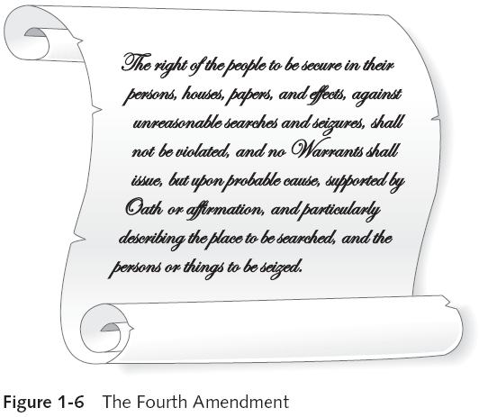
Fourth amendment

Slide 18
The Fourth Amendment
Law enforcement officers forcing a suspect to unlock their mobile device after an arrest may be deemed unconstitutional.
Riley vs. California, The US Supreme Court unanimously ruled that warrantless search and seizure of a cell phone during an arrest is unconstitutional

Slide 19
Electronic Communications Privacy Act
Example of this protection would be seizing evidence from an ISP and attempting to investigate the millions of customer accounts beyond the particular user of interest.
Anything found on users outside of the person of interest would be a clear violation of the ECPA

Slide 20
Opening a case
Take notes as soon as you open the case
Use a case management application so that you are guided as you document each step taken
Case management applications:
Date and time Place and location of incident Whether the evidence is on a volatile system or nonvolatile system Details of persons present at the crime scene Names and identification of people who can serve as witnesses Documentation, pictures, and videos

Slide 21
Autopsy
is a collection of tools that can be accessed using a simple GUI in Kali Linux.
to analyze the disk images that have been collected in the investigation, but it can also be your case management tool

Slide 22
First Responder
Not every situation requires a first responder.
Group being engaged after a security incident requiring forensic services is needed.
identifying and documenting the current state of the area involving the incident-investigation notes start here.

Slide 23
Responder Responsibilities
Block off the area involving the incident.
Document all systems involved and potential systems to be investigated.
Photograph and record all details of the system’s current state.
Gather names of any people who could be witnesses.
Assess any dangers or threats to the investigation.
Engage any required outside parties such as authorities or data owners.
Alert the incident response team.
Decide the next course of action (outsource, investigate with internal services, et

Slide 24
Your responsibilities
Your team may become the first responder or be called in to take over the investigation, so you will need to engage with the first responder.
What tools do you need as a responder?

